Slide 1


LOOPING
What is Looping?
The process of repeatedly executing a block of statements until a given condition returns false

Slide 2
Why do we need looping?
LOOPING
Without loop
void main()
{
printf(“Be Happy”);
printf(“Be Happy”);
printf(“Be Happy”);
printf(“Be Happy”);
printf(“Be Happy”);
getch();
}
With loop
void main()
{
int i;
for(i=1;i<=5;i++)
{
printf(“Be happy”);
}
getch();
}

Slide 3
LOOPING
Looping statements consists of three parts
Initialization
Condition
Increment / Decrement

Slide 4
LOOPING
Following 4 steps for looping process
Setting and intialization of counter/loop
control Variable
Execution of statements in the loop
Test for a specified condition for execution of
the loop
Incrementing the counter

Slide 5
Depending on the position of the control statement in the loop ,a control structure may be classified either as the entry -controlled loop or as exit-controlled loop
TYPES
Entry
Entry
Test condition
False
Body of the loop
True
Body of the Loop
Test condition
False
True
Entry-Control
Exit-Control

Slide 6
Types
Three types
For Loop(Entry Controlled Loop)
While Loop (Entry Controlled Loop)
Do while (Exit Controlled Loop)

Slide 7
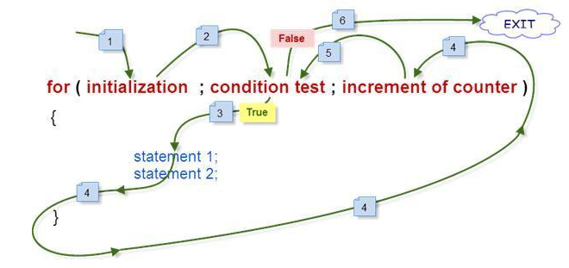
Types
Flow of Execution

Slide 8
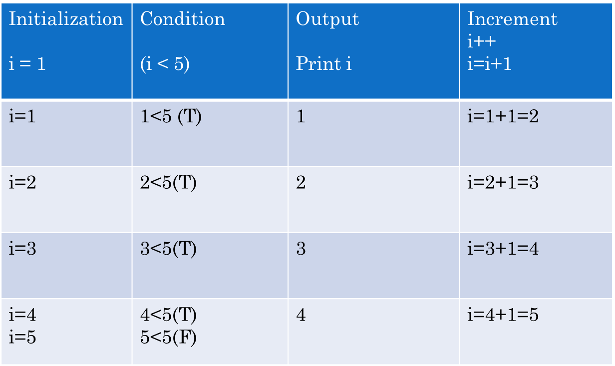
For Loop
Types
for(i=1;i<5;i++)
{
printf(“%d”,i);
}

Slide 9
FOR
ion
The For loop is an entry-controlled loop statement.
for(initialization;test condition;incre/decre)
{
Body of the loop;
}
for(i=0;i<5;i++)
{
printf(“%d”,i);
}
i=0,1,2,3,4
i=0;
0<5->true
Print 0
i=i+1 (0r) i=1
i=1;
1<5 ->true
Print 1
i=i+1 (0r) i=2
i=2;
2<5 ->true
Print 2
i=i+1 (0r) i=3
i=3;
3<5->true
Print 3
i=i+1 (0r) i=4
i=4;
4<5->true
Print 4
i=i+1 (0r) i=5

Slide 10
Illustration of for loop
Types
#include <stdio.h>
int main()
{
int i;
for (i = 1; i <= 10; i++)
{
printf( “Keep smiling\n");
}
return 0;
}
#include <stdio.h>
int main()
{
int i;
for (i = 1; i <= 10; i++)
{
printf( “%d\n“,i);
}
return 0;
}

Slide 11
While
ion
The While is an entry-controlled loop statement.
Syntax
Initialization;
While(test condition)
{
Body of the loop;
Incre/decre;
}
i=0;
While(i<5)
{
Printf(“%d”,i);
i++;
}
i=0,1,2,3,4
i=0;
0<5->true
Print 0
i=i+1 (0r) i=1
i=1;
1<5 ->true
Print 1
i=i+1 (0r) i=2
i=2;
2<5 ->true
Print 2
i=i+1 (0r) i=3
i=3;
3<5->true
Print 3
i=i+1 (0r) i=4
i=4;
4<5->true
Print 4
i=i+1 (0r) i=5

Slide 12
Illustration of while loop
Types
#include <stdio.h>
int main()
{
int i=1
while(i <= 10)
{
printf( “Keep smiling\n");
i++;
}
return 0;
}
#include <stdio.h>
int main()
{
int i=1;
while (i <= 10)
{
printf( “%d\n“,i);
i++;
}
return 0;
}

Slide 13
DOWHILE
ion
The Do loop is an exit-controlled loop statement.
Initialization;
do
{
Body of the loop;
}
While(testcondition);
i=0
do
{
printf(“%d”,i);
i++;
}
While(i<5);
i=0,1,2,3,4
i=0;
Print 0
i=i+1 (0r) i=1
0<5->true
i=1;
Print 1
i=i+1 (0r) i=2
1<5 ->true
i=2;
Print 2
i=i+1 (0r) i=3
2<5 ->true
i=3;
Print 3
i=i+1 (0r) i=4
3<5->true
i=4;
Print 4
i=i+1 (0r) i=5
4<5->true

Slide 14
Illustration of do while loop
Types
#include <stdio.h>
int main()
{
int i=1;
do
{
printf( “Keep smiling\n");
i++;
}while(i <= 10)
return 0;
}
##include <stdio.h>
int main()
{
int i=1;
do
{
printf( “%d\n“,i);
i++;
}while(i <= 10)
return 0;
}

Slide 15
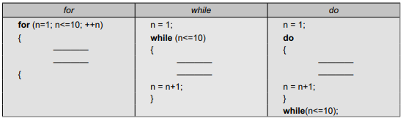
DOWHILE
Comparison of the three loops

